Slide 1
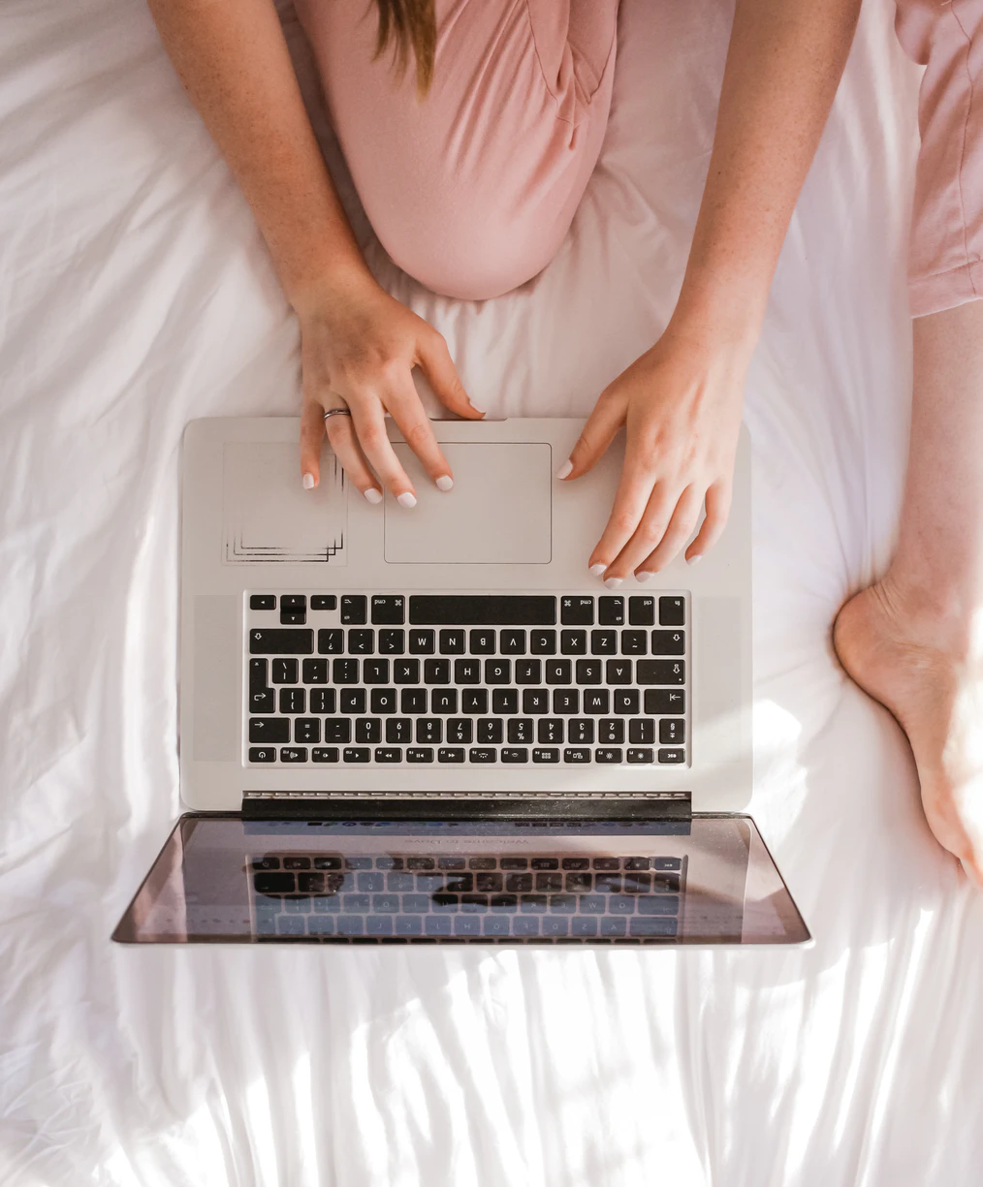
Facial Recognition
BDA-2008 - "qwerty"
Group: Damir Sarsenov, Togzhan Baydish, Aibolsyn Aibekqyzy, Amir Yakubov

Slide 2
Program.
What is our project about
Application
Code
Things to do.

Slide 3
01
We will talk about this first.
Face recognition Is the hottest topic of recent decades. It is used everywhere, from using it for verification in such serious areas of activity as banks, and ending with the creation of masks in Snapchat

Slide 4
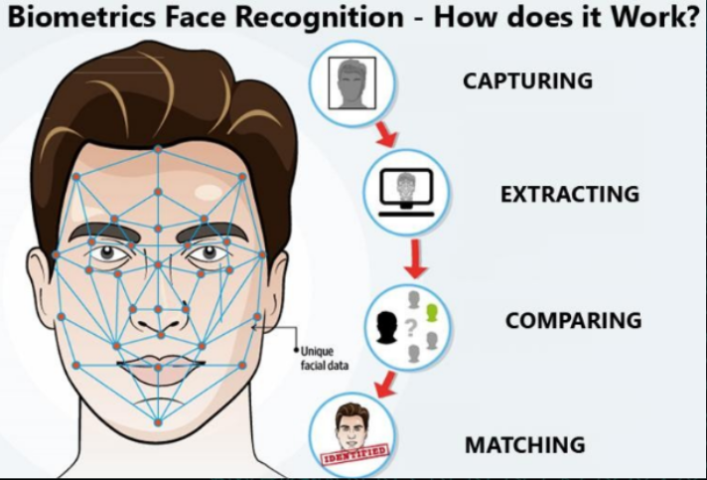
How does it work?

Slide 5
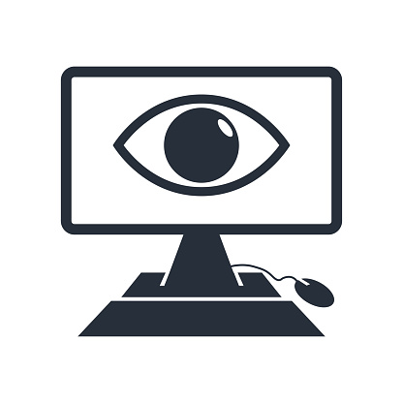
Did you know?
In some narrow use cases, computer vision is more effective than human vision.
Google's CV team developed a machine that can diagnose diabetic retinopathy better than a human ophthalmologist. Diabetic retinopathy is a complication that can cause blindness in diabetic patients, but it is treatable if caught early.

Slide 6
Computer Vision for Verification
We are going to write a program that will record a person's face and get the necessary parameters from him

Slide 7
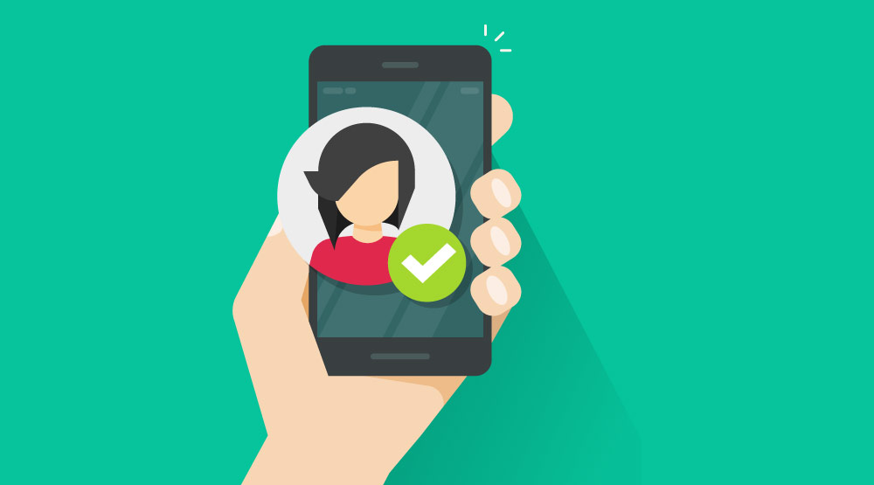
02
Application.

Slide 8
Our project can be useful everywhere.
Authorization
Proof of payment
Data can be tied to each person
You want to prevent fraud? Easy!

Slide 9
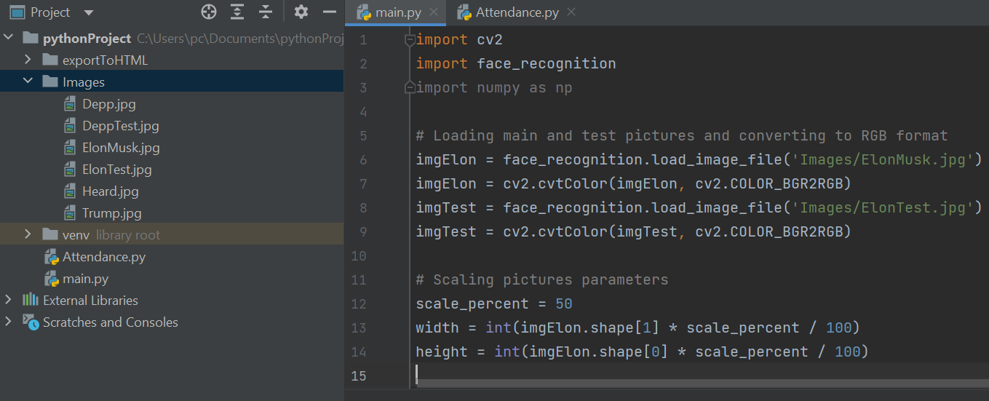
03
Code.

Slide 10
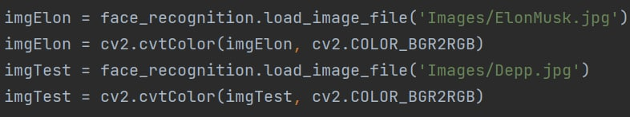
Import
Loading main and test pictures and converting them to RGB format.

Slide 11
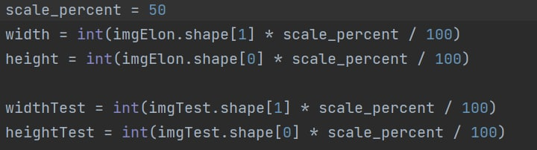
Adjustment
Scaling pictures parameters.

Slide 12
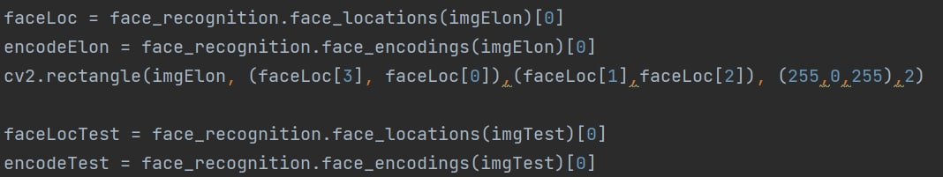
Encoding
Here we encode pictures by using Histogram of Oriented Gradients. The image is feed to a pretrained neural network that out puts 128 measurements that are unique to that particular face.

Slide 13
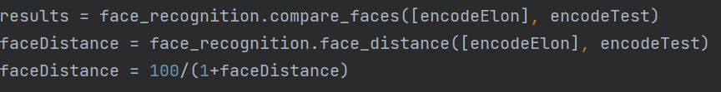
Comparing
To compare the package uses SVM classifier. The function return True or False, whether the face is the same or not.

Slide 14
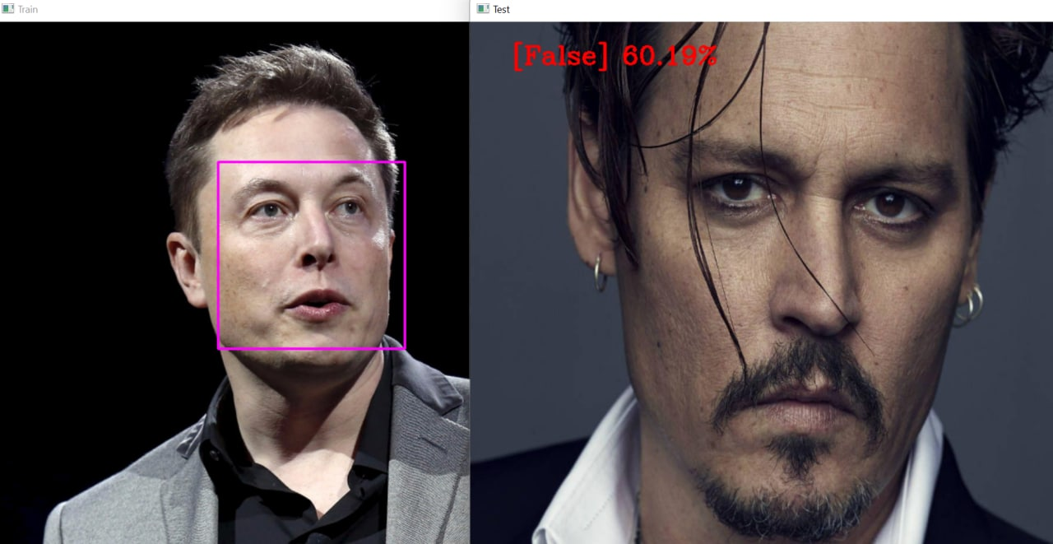
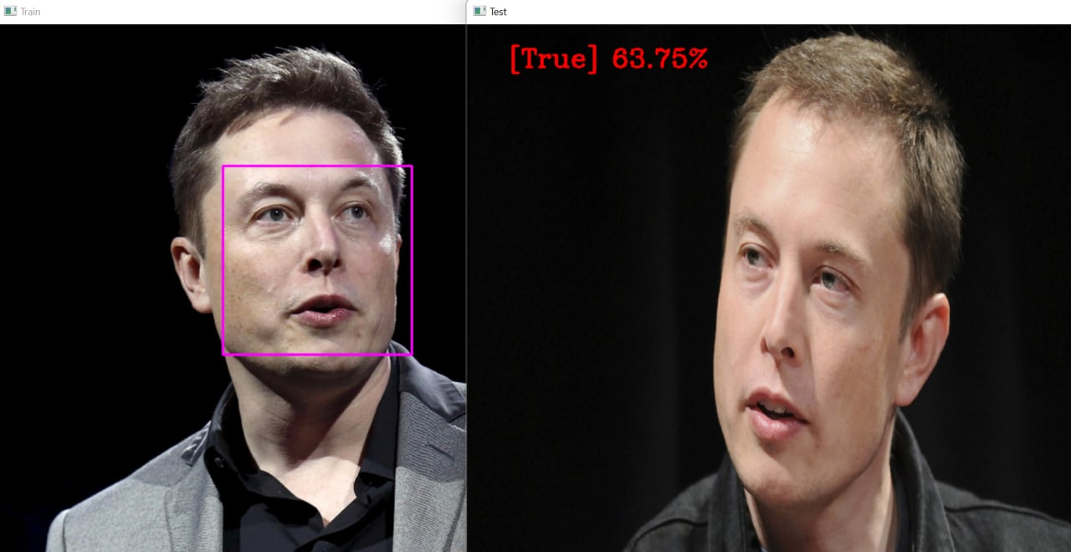
The result
The higher the accuracy – the greater chance that we got similar faces. For the picture, it must have an euclidean distance to be lower than 0.4

Slide 15
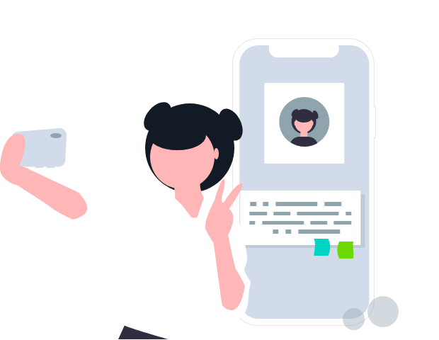
04
Things to do.

Slide 16

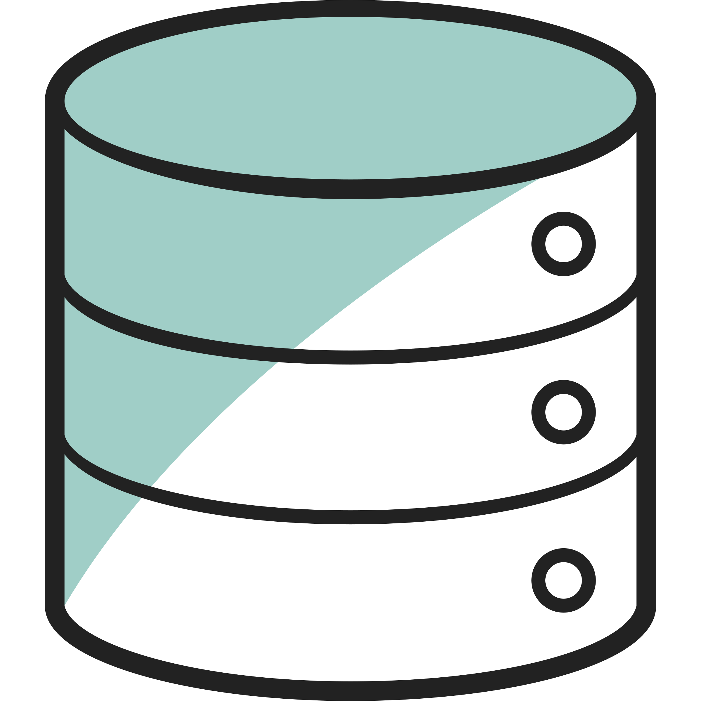
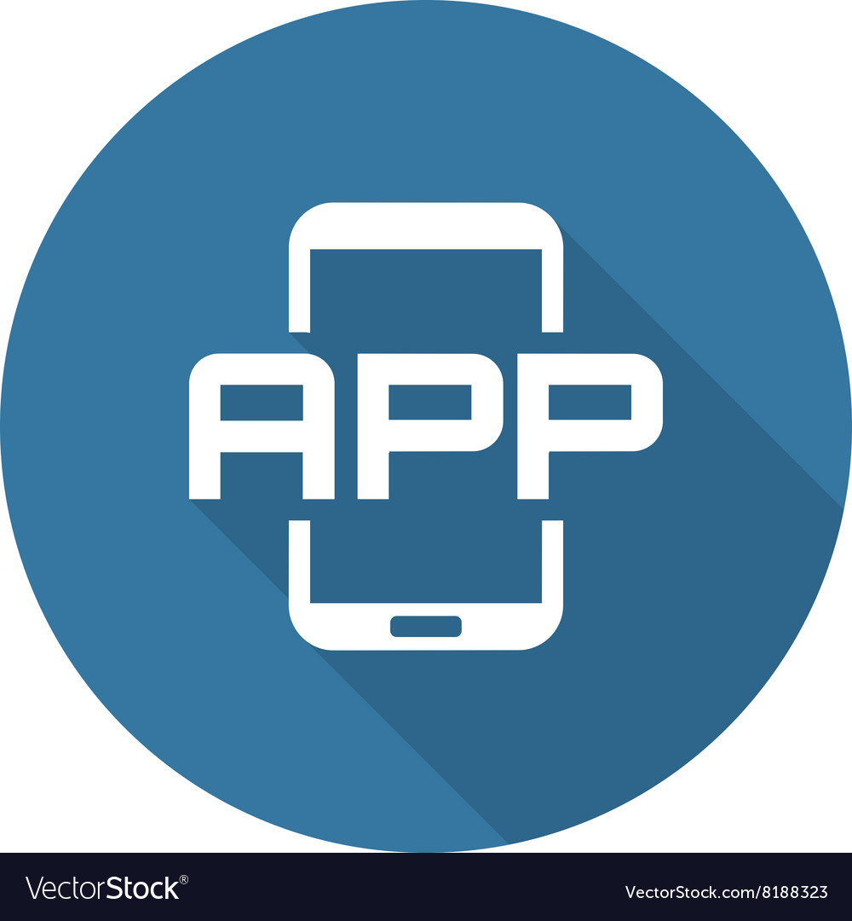
Attendance.
We are going to create a process, where a user will record himself and send his data
Database.
The data is needed to be stored somewhere, so we would extract it and use for our purposes
Use.
We will implement the program into telegram bot or a website, so anyone will have a chance to test it out!

